Slide 1

Team Members: Stephen Burke, Binita Singh, Erriel Tota, Thomas Tran

Slide 2
Topic: Mental Health Poll
Dataset Domain: kaggle.com
Dataset Source: https://www.kaggle.com/ashkhagan/mental-health-poll

Slide 3
Goals:
To determine what cities in Missouri have college ranked as the number one thing that stresses them out the most
To see if people (in Missouri) are using any resources to help with their mental health and to see which resources people use the most.
To see which region has the highest number of people who talk to friends when they are stressed.

Slide 4
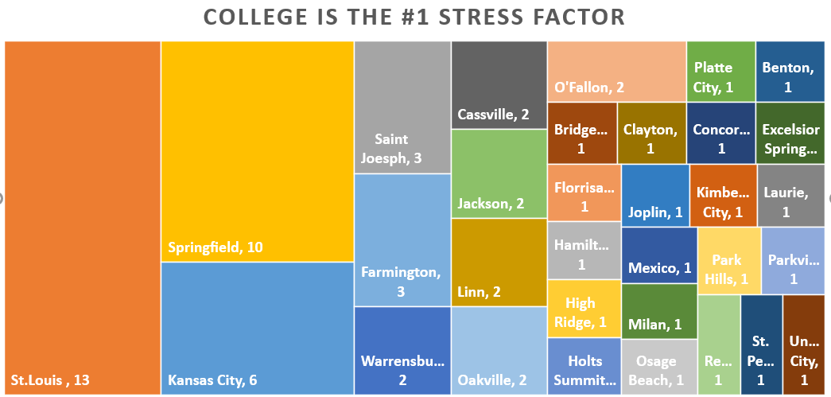
First Goal
Treemap

Slide 5
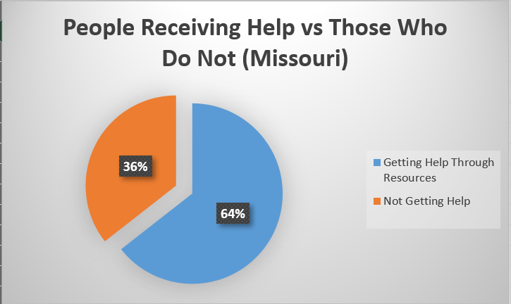
Second Goal
Pie-chart

Slide 6
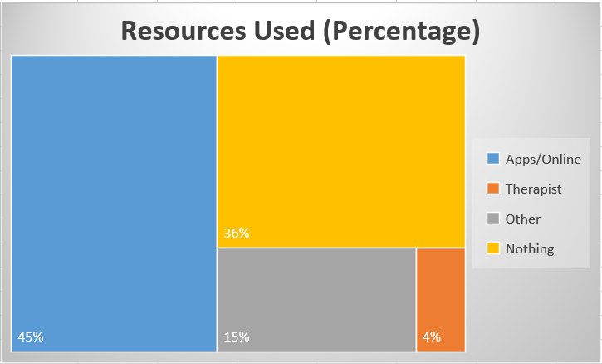
Second Goal
Treemap

Slide 7
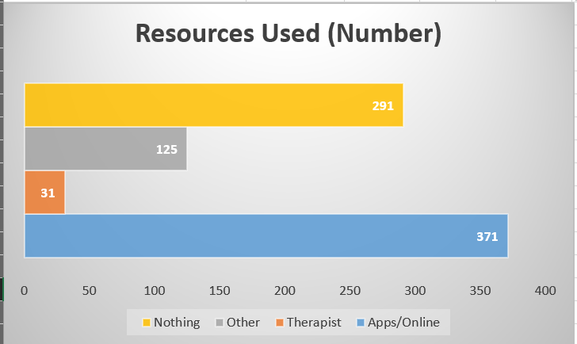
Second Goal
Horizontal Bar-chart

Slide 8
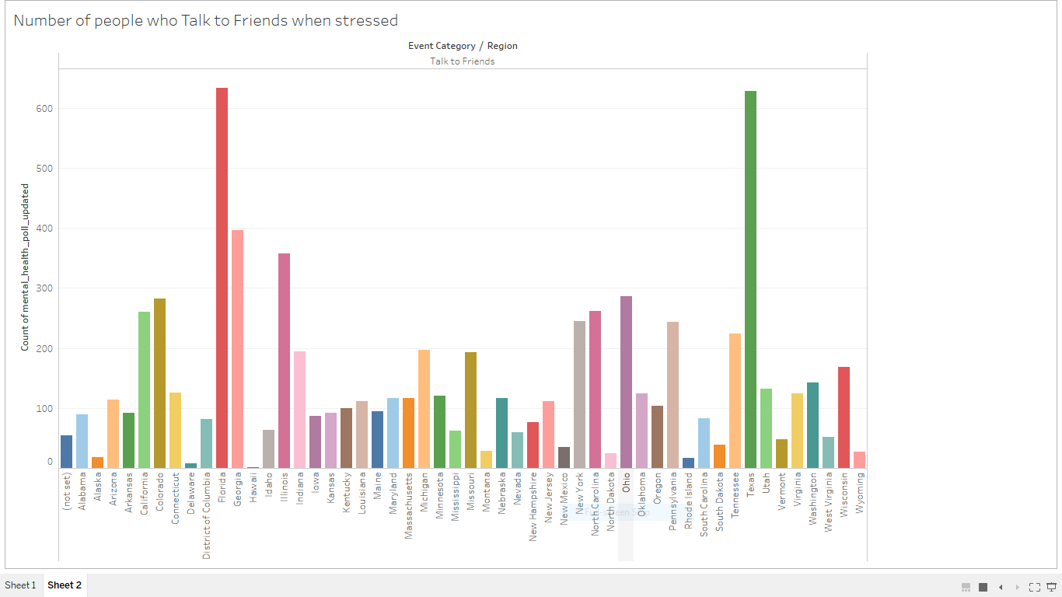
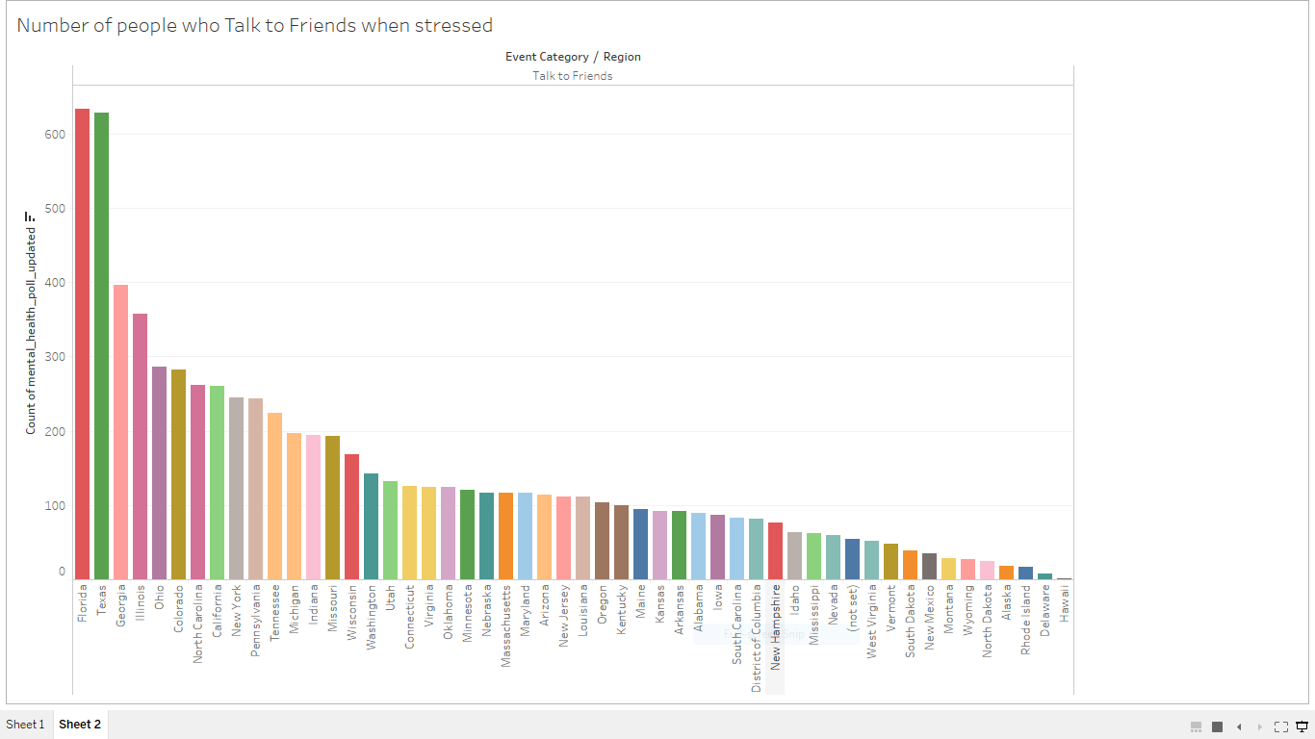
Data sorted by name of region
Data sorted in descending order by count
Third Goal
Side-by-side Bar

Slide 9
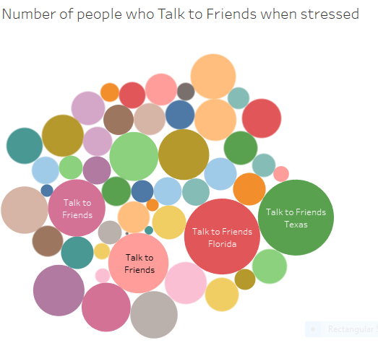
Third Goal
Packed Bubbles

Slide 10
Thank you

